Slide 1

olaris Health

Slide 2


Slide 3


Slide 4
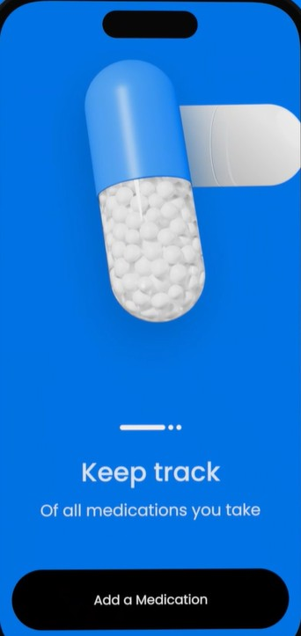

Slide 5

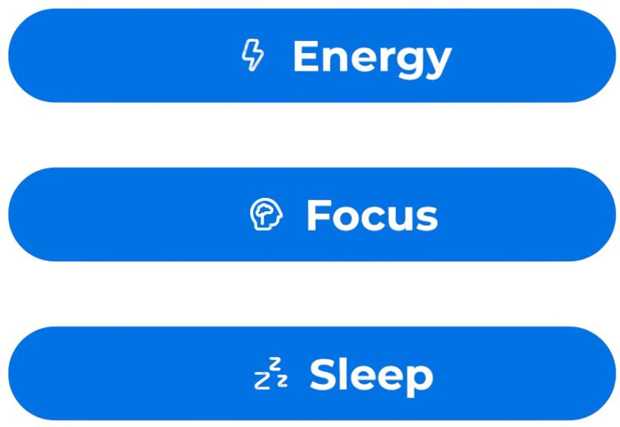

Slide 6


POLARIS HEALTH
16:32
06
APR
It’s on the way
You’ll receive your first Polaris Health pack before 5pm today.
POLARIS HEALTH
09:12
12
MAY
Your first pouch
All great journeys start with a single step. It’s time to take your first pouch.
POLARIS HEALTH
12:00
18
AUG
Final Refill
Reminder: This is your final refill. Please reorder soon to avoid interruptions in your medication supply.

Slide 7
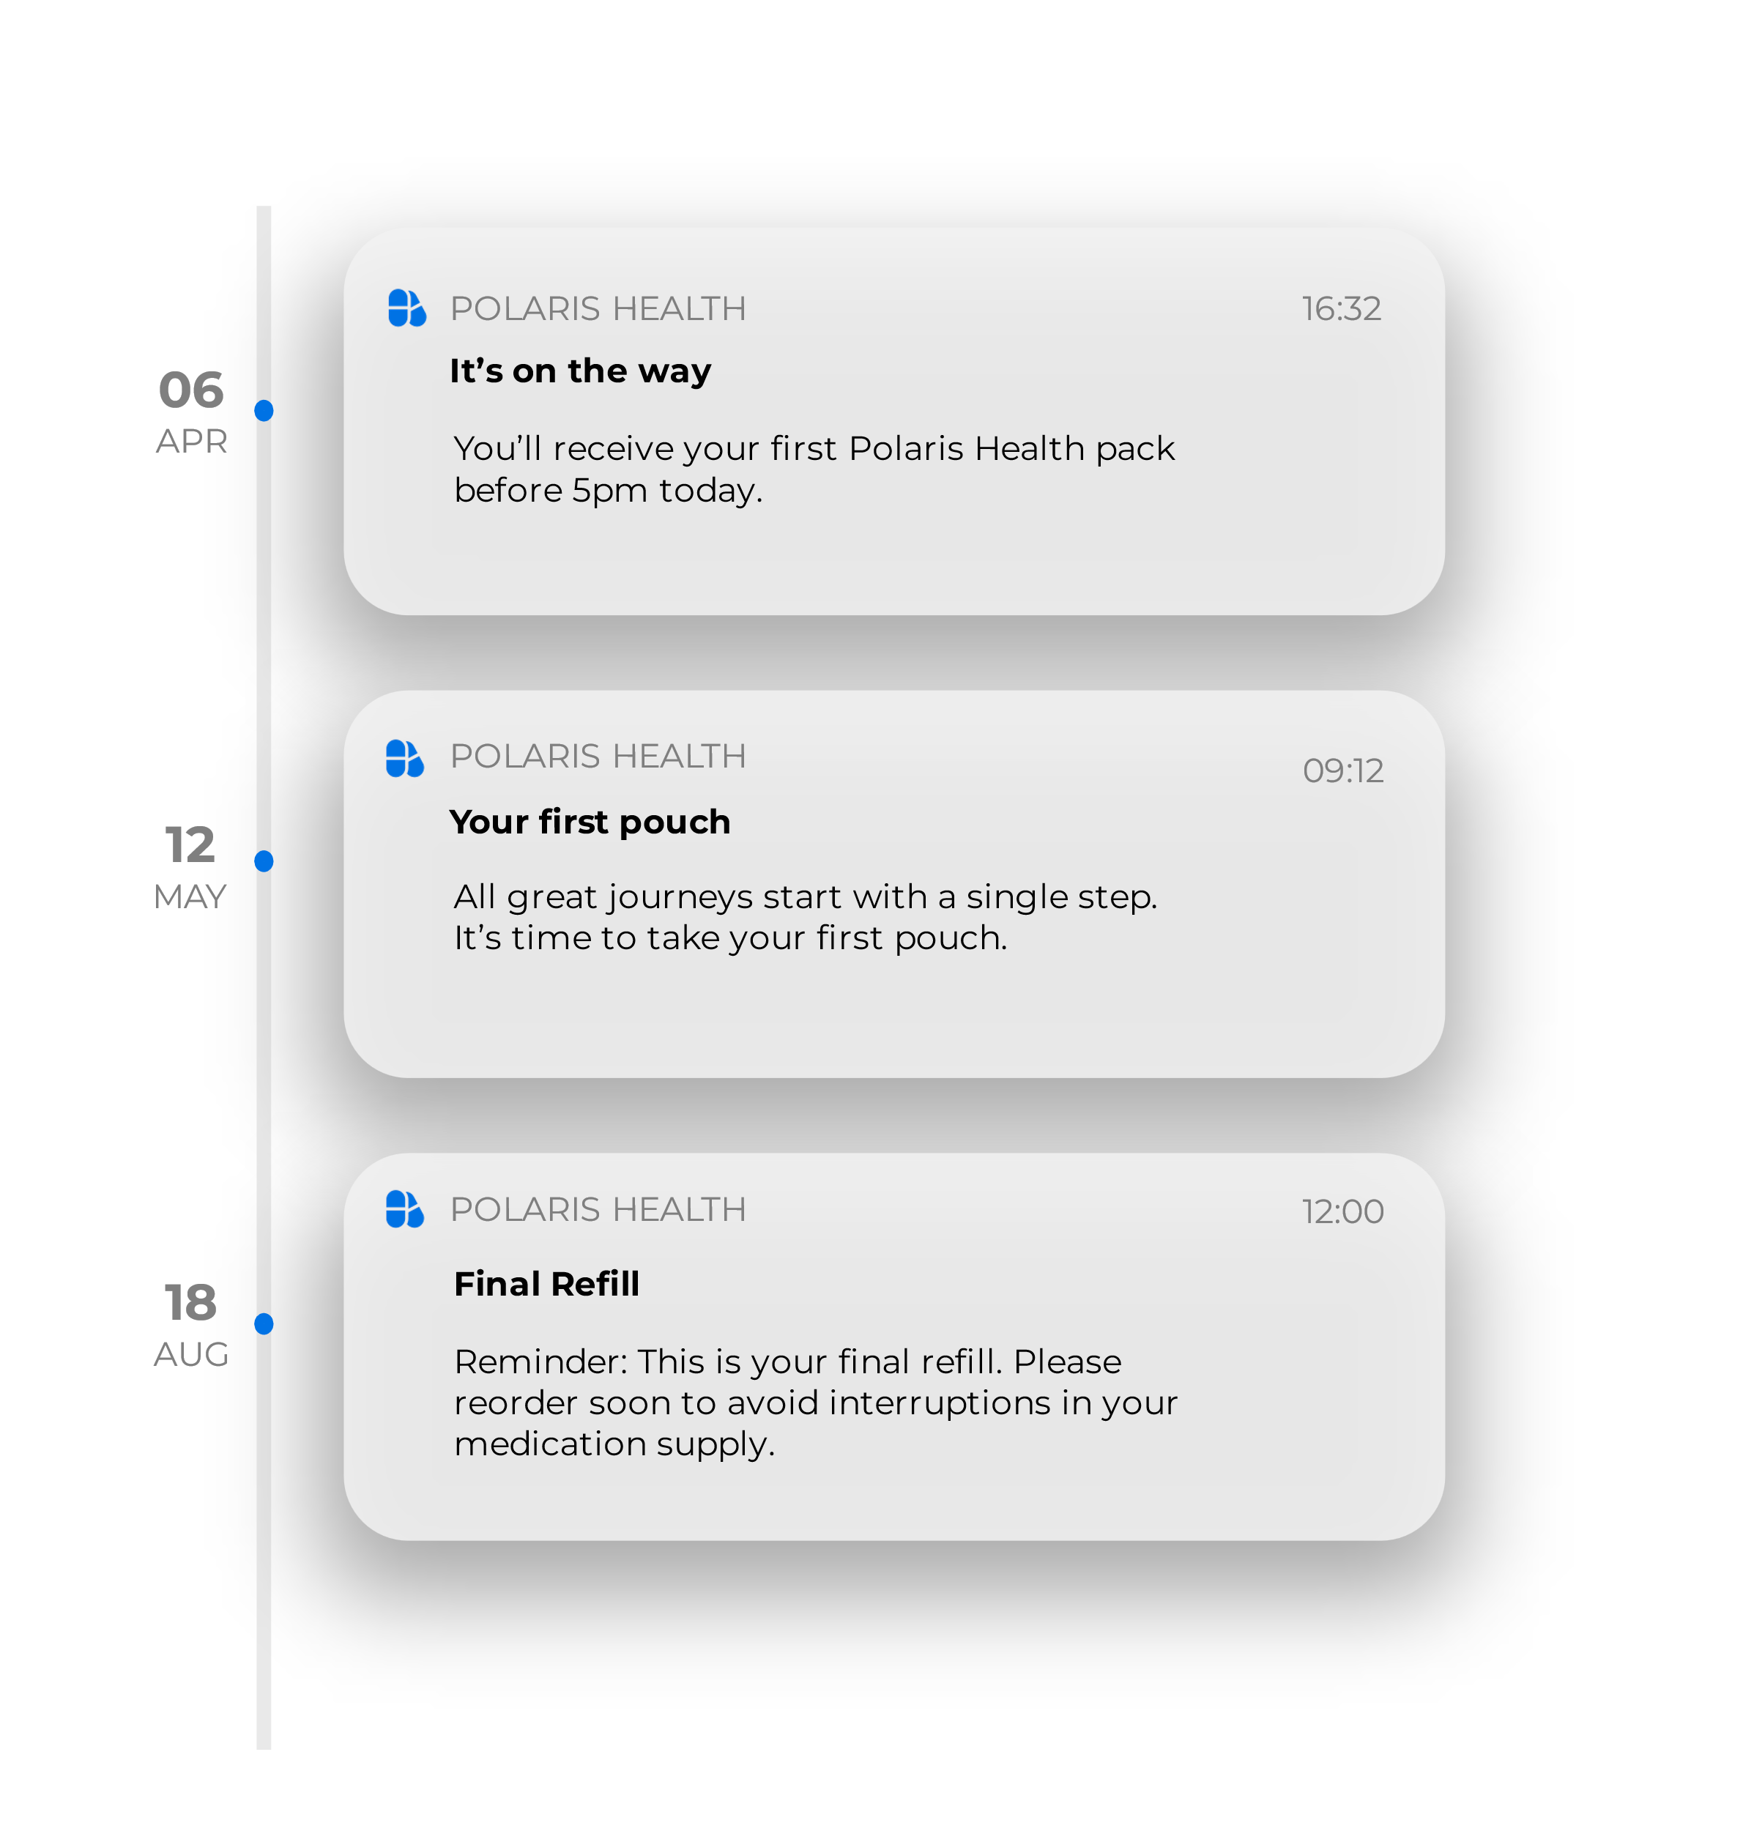

Slide 8




Magtein
Sleep
Focus & Memory

Slide 9
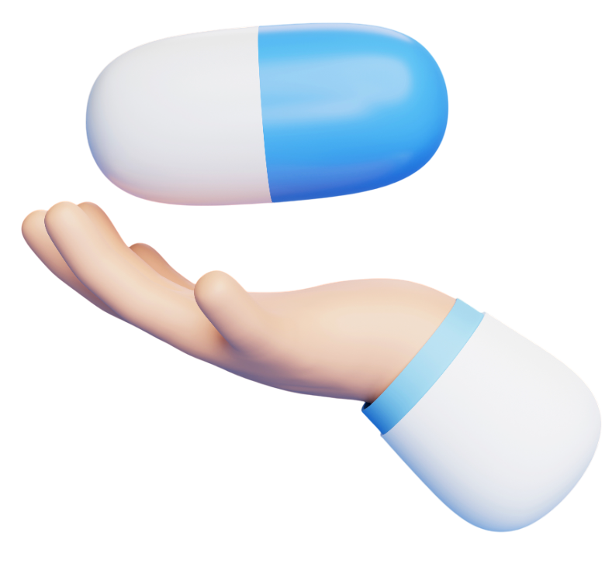

Super-B Complex
Stress
Focus & Memory
Energy

Slide 10
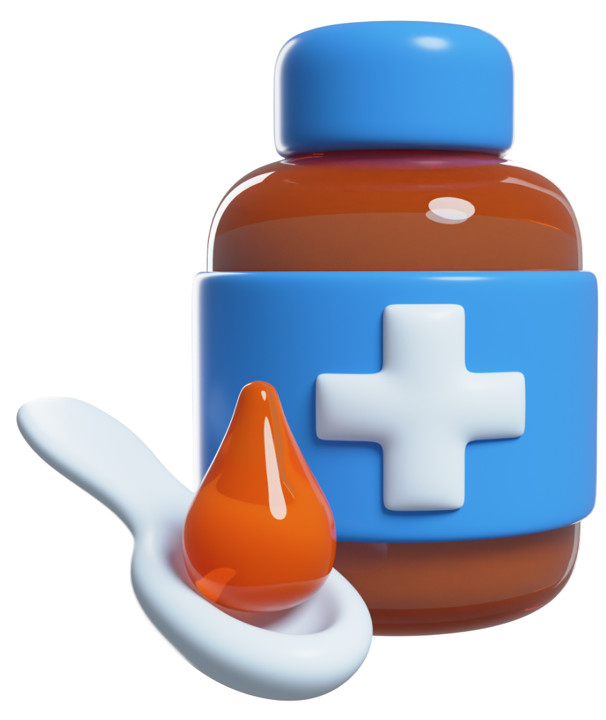
Fish Oil
Sleep
Focus & Memory

